Slide 1

Data Management Using Microsoft SQL Server
SQL
Server
2012
Session: 1
Introduction to the Web
Session: 8
Accessing Data

Slide 2



SQL
Server
2012
SQL
Server
2012
Describe the SELECT statement, its syntax, and use
Explain the various clauses used with SELECT
State the use of ORDER BY clause
Describe working with typed and untyped XML
Explain the procedure to create, use, and view XML schemas
Explain the use of Xquery to access XML data

Slide 3

SQL
Server
2012
The SELECT statement is a core command used to access data in SQL Server 2012.
XML allows developers to develop their own set of tags and makes it possible for other programs to understand these tags.
XML is the preferred means for developers to store, format, and manage data on
the Web.
SQL
Server
2012

Slide 4


SQL
Server
2012
SQL
Server
2012
A table with its data can be viewed using the SELECT statement.
The output of the SELECT statement is another table called resultset.
The SELECT statement defines the columns to be used for a query.

Slide 5

SQL
Server
2012
SQL
Server
2012
The syntax of SELECT statement can consist of a series of expressions separated by commas.
The columns appear in the same sequence as the order of the expression in the
SELECT statement.
The syntax for the SELECT statement is as follows:
Syntax:
SELECT <column_name1>...<column_nameN> FROM <table_name>
where,
table_name: is the table from which the data will be displayed.
<column_name1>...<column_nameN>: are the columns that are to be displayed.

Slide 6

SQL
Server
2012
SQL
Server
2012
Many SQL versions use FROM in their query, but in all the versions from SQL Server 2005, including SQL Server 2012, one can use SELECT statements without using the FROM clause.
SELECT LEFT('International',5)
The code will display only the first five characters from the extreme left of the word 'International'.
The output is shown in the following figure:

Slide 7
SQL
Server
2012
SQL
Server
2012
The asterisk (*) is used in the SELECT statement to retrieve all the columns from the table.
The syntax for selecting all columns is as follows:
Syntax:
SELECT * FROM <table_name>
where,
*: specifies all columns of the named tables in the FROM clause.
<table_name>: is the name of the table from which the information is to be
retrieved. It is possible to include any number of tables. When two or more tables are used, the row of each table is mapped with the row of others. This activity takes a lot of time if the data in the tables are huge. Hence, it is recommended to use this syntax with a condition.

Slide 8
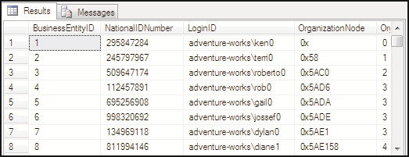
SQL
Server
2012
Following code snippet demonstrates the use of ' * ' in the SELECT statement:
SQL
Server
2012
USE AdventureWorks2012
SELECT * FROM HumanResources.Employee GO
The partial output with some columns of HumanResources.Employee table is shown in the following figure:

Slide 9
SQL
Server
2012
SQL
Server
2012
The SELECT statement displays or returns certain relevant columns that are chosen by the user or mentioned in the statement.
The syntax for selecting specific columns is as follows:
Syntax:
SELECT <column_name1>..<column_nameN> FROM <table_name>
where,
<column_name1>..<column_nameN>: are the columns that are to be displayed.

Slide 10
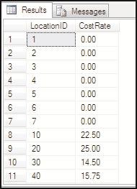
SQL
Server
2012
SQL
Server
2012
For example, to display the cost rates in various locations from Production.Location table in AdventureWorks2012 database, the SELECT statement is as shown in the following code snippet:
USE AdventureWorks2012
SELECT LocationID,CostRate FROM Production.Location GO
Following figure shows LocationID and CostRate columns from
AdventureWorks2012 database:

Slide 11


SQL
Server
2012
SQL
Server
2012
Character string constants are used when character columns are joined.
These constants are not specified as a separate column in the resultset.

Slide 12
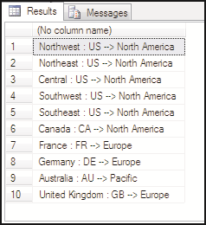
SQL
Server
2012
SQL
Server
2012
For example, to include ' : ' and '→' in the resultset so as to display the country name, country region code, and its corresponding group, the SELECT statement is shown in the following code snippet:
USE AdventureWorks2012
SELECT [Name] +':'+ CountryRegionCode +'→'+ [Group] FROM Sales.SalesTerritory
GO
Following figure displays the country name, country region code, and corresponding
group from Sales.SalesTerritory of AdventureWorks2012 database:

Slide 13


SQL
Server
2012
SQL
Server
2012
When columns are displayed in the resultset they come with corresponding
headings specified in the table.
Therefore, by customizing the headings, they become more understandable and meaningful.

Slide 14

SQL
Server
2012
SQL
Server
2012
Following code snippet demonstrates how to display 'ChangedDate' as the heading for ModifiedDate column in the dbo.Individual table, the SELECT statement:
USE CUST_DB
SELECT ModifiedDate as 'ChangedDate' FROM dbo.Individual GO
The output displays 'ChangedDate' as the heading for ModifiedDate column in the dbo.Individual table.
Following figure shows the original heading and the changed heading:

Slide 15



SQL
Server
2012
SQL
Server
2012
A SELECT statement can contain mathematical expressions by applying operators
to one or more columns.
For example, consider the table Production.ProductCostHistory from
AdventureWorks2012 database.

Slide 16

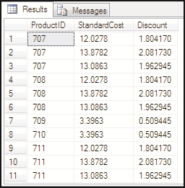
SQL
Server
2012
SQL
Server
2012
The discount amount does not exist, but can be calculated by executing the
SELECT statement shown in the following code snippet:
USE AdventureWorks2012
SELECT ProductID,StandardCost,StandardCost * 0.15 as Discount FROM Production.ProductCostHistory
GO
Following figure shows the output where discount amount is calculated using
SELECT statement:

Slide 17

SQL
Server
2012
SQL
Server
2012
The keyword DISTINCT prevents the retrieval of duplicate records.
For example, if the StandardCost column is selected without using the
DISTINCT keyword, it will display all the standard costs present in the table.
USE AdventureWorks2012
SELECT DISTINCT StandardCost FROM Production.ProductCostHistory
GO

Slide 18
SQL
Server
2012
SQL
Server
2012
The TOP keyword will display only the first few set of rows as a resultset.
The TOP expression can also be used with other statements such as INSERT, UPDATE, and DELETE.
The syntax for the TOP keyword is as follows:
Syntax:
SELECT [ALL|DISTINCT] [TOP expression [PERCENT] [WITH TIES]]
where,
expression: is the number or the percentage of rows to be returned as the result.
PERCENT: returns the number of rows limited by percentage.
WITH TIES: is the additional number of rows that is to be displayed.

Slide 19
SQL
Server
2012
SQL
Server
2012
The INTO clause creates a new table and inserts rows and columns listed in the
SELECT statement into it.
In order to execute this clause with the SELECT statement, the user must have the permission to CREATE TABLE in the destination database.
The syntax for the SELECT statement is as follows:
Syntax:
SELECT <column_name1>..<column_nameN> [INTO new_table] FROM table_list
where,
new_table: is the name of the new table that is to be created.

Slide 20
SQL
Server
2012
SQL
Server
2012
Following code snippet uses an INTO clause which creates a new table Production.ProductName with details such as the product's ID and its name from the table Production.ProductModel:
USE AdventureWorks2012
SELECT ProductModelID,Name INTO Production.ProductName FROM Production.ProductModel
GO
After executing the code, a message stating '(128 row(s) affected)' is displayed.

Slide 21
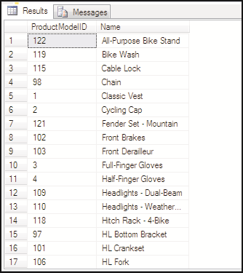
SQL
Server
2012
SQL
Server
2012
If a query is written to display the rows of the new table, the output will be as shown in the following figure:

Slide 22
SQL
Server
2012
SQL
Server
2012
The WHERE clause with SELECT statement is used to conditionally select or limit the records retrieved by the query.
The row is returned if the expression is true and is discarded if it is false.
The syntax for the SELECT statement is as follows:
Syntax:
SELECT <column_name1>...<column_nameN> FROM <table_name> WHERE < search_condition>]
where,
search_condition: is the condition to be met by the rows.

Slide 23
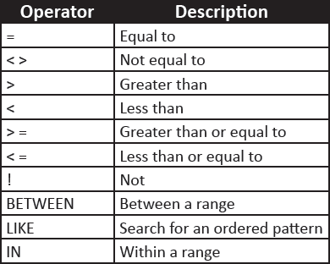
SQL
Server
2012
SQL
Server
2012
Following table shows the different operators that can be used with the WHERE
clause:

Slide 24
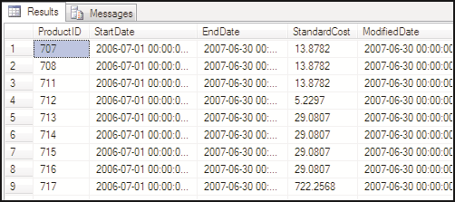
SQL
Server
2012
SQL
Server
2012
Following code snippet demonstrates the equal to operator with WHERE clause to display data with EndDate 6/30/2007 12:00:00 AM:
USE AdventureWorks2012
SELECT * FROM Production.ProductCostHistory WHERE EndDate = '6/30/2007 12:00:00 AM'
GO
The output SELECT with WHERE clause is shown in the following figure:

Slide 25
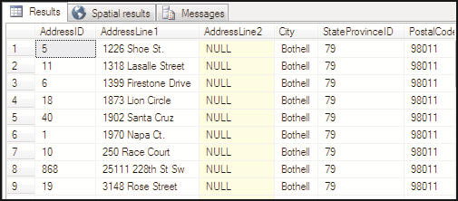
SQL
Server
2012
SQL
Server
2012
All queries in SQL use single quotes to enclose the text values.
For example, consider the following query, which retrieves all the records from
Person.Address table having Bothell as city.
Following code snippet demonstrates the equal to operator with WHERE clause to display data with address having Bothell city.
USE AdventureWorks2012
SELECT DISTINCT StandardCost FROM Production.ProductCostHistory
GO
The output of the query is shown in the following figure:

Slide 26
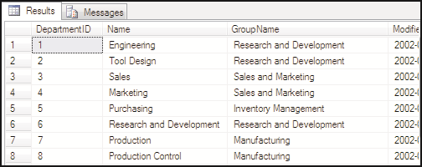
SQL
Server
2012
SQL
Server
2012
Numeric values are not enclosed within any quotes as shown in the following code snippet:
USE AdventureWorks2012
SELECT * FROM HumanResources.Department WHERE DepartmentID < 10 GO
The query displays all those records where the value in DepartmentID is less than
10.
The output of the query is shown in the following figure:

Slide 27
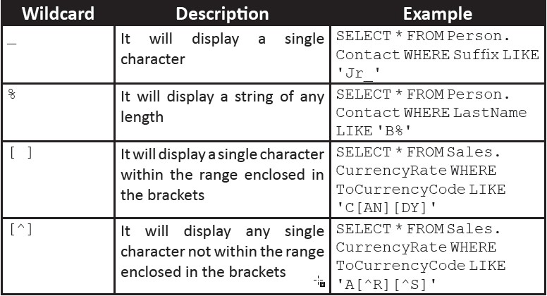
SQL
Server
2012
SQL
Server
2012
WHERE clause can also be used with wildcard characters as shown in the following table:
All wildcard characters are used along with LIKE keyword to make the query accurate and specific.

Slide 28
SQL
Server
2012
SQL
Server
2012
WHERE clause also uses logical operators such as AND, OR, and NOT. These operators are used with search conditions in WHERE clauses.
So, it returns all the rows from the tables where both the conditions that are listed are true. Following code snippet demonstrates the use of AND operator:
USE AdventureWorks2012
SELECT * FROM Sales.CustomerAddress WHERE AddressID > 900 AND
AddressTypeID = 5
GO

Slide 29
SQL
Server
2012
SQL
Server
2012
OR operator returns TRUE and displays all the rows if it satisfies any one of the conditions. Following code snippet demonstrates the use of OR operator:
USE AdventureWorks2012
SELECT * FROM Sales.CustomerAddress WHERE AddressID < 900 OR AddressTypeID = 5
GO
The query will display all the rows whose AddressID is less than 900 or whose
AddressTypeID is equal to five.
The NOT operator negates the search condition.
Following code snippet demonstrates the use of NOT operator:
USE AdventureWorks2012
SELECT * FROM Sales.CustomerAddress WHERE NOT AddressTypeID = 5 GO
The code will display all the records whose AddressTypeID is not equal to 5.
Multiple logical operators in a single SELECT statement can be used.
When more than one logical operator is used, NOT is evaluated first, then AND, and finally OR.

Slide 30
SQL
Server
2012
SQL
Server
2012
The GROUP BY clause partitions the resultset into one or more subsets. Each subset has values and expressions in common.
Every grouped column restricts the number of rows of the resultset. For every
grouped column, there is only one row.
Syntax:
SELECT <column_name1>..<column_nameN> FROM <table_name> GROUP BY <column
_name>
where,
column_name1: is the name of the column according to which the resultset should
be grouped.

Slide 31
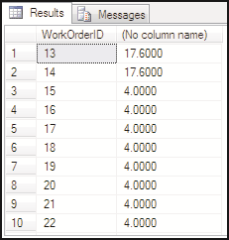
SQL
Server
2012
SQL
Server
2012
For example, consider that if the total number of resource hours has to be found for each work order, the query in the following code snippet would retrieve the resultset:
USE AdventureWorks2012
SELECT WorkOrderID,SUM(ActualResourceHrs) FROM Production.WorkOrderRouting GROUP BY WorkOrderID GO
The output is shown in the following figure:

Slide 32
SQL
Server
2012
SQL
Server
2012
Microsoft SQL Server 2012 provides enhanced query syntax elements for more powerful data accessing and processing.
Common Table Expression (CTE) in SELECT and INSERT statement
A CTE is a named temporary resultset based on the regular SELECT and INSERT
query.
Following code snippet demonstrates the use of CTE in INSERT statement:
USE CUST_DB
CREATE TABLE NewEmployees (EmployeeID smallint,FirstName char(10), LastName char(10), Department varchar(50), HiredDate datetime, Salary money );
INSERT INTO NewEmployees
VALUES(11,'Kevin','Blaine', 'Research', '2012-07-31', 54000);
WITH EmployeeTemp (EmployeeID,FirstName,LastName,Department, HiredDate,Salary)
AS
(
SELECT * FROM NewEmployees
)
SELECT * FROM EmployeeTemp

Slide 33

SQL
Server
2012
SQL
Server
2012
The query inserts a new row for the NewEmployees table and transfers the temporary resultset to EmployeeTemp as shown in the following figure:
OUTPUT clause in INSERT and UPDATE statements
The OUTPUT clause returns information about rows affected by an INSERT
statement and an UPDATE statement.
Following code snippet demonstrates how to use UPDATE statement with an
INSERT statement:
USE CUST_DB;
GO

Slide 34
SQL
Server
2012
CREATE TABLE dbo.table_3 (
id INT,
employee VARCHAR(32)
)
go
INSERT INTO dbo.table_3 VALUES
(1, 'Matt')
,(2, 'Joseph')
,(3, 'Renny')
,(4, 'Daisy'); GO
DECLARE @updatedTable TABLE
(
id INT, olddata_employee VARCHAR(32), newdata_employee VARCHAR(32)
);
UPDATE dbo.table_3
Set employee= UPPER(employee)
SQL
Server
2012

Slide 35
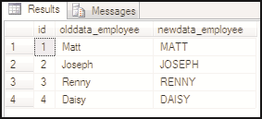
SQL
Server
2012
SQL
Server
2012
OUTPUT
inserted.id,
deleted.employee, inserted.employee INTO @updatedTable
SELECT * FROM @updatedTable
The output where rows are affected by an INSERT statement and an UPDATE
statement is shown in the following figure:

Slide 36

SQL
Server
2012
SQL
Server
2012
.WRITE clause
.WRITE clause is used in an UPDATE statement to replace a value in a column having large value data type.
The syntax for the .WRITE clause is as follows:
Syntax:
.WRITE(expression, @offset, @Length)
where,
expression: is the character string which is to be placed into the large value data
type column.
@offset: is the starting value (units) where the replacement is to be done.
@Length: is the length of the portion in the column, starting from @offset that is replaced by expression.

Slide 37
SQL
Server
2012
SQL
Server
2012
Following code snippet demonstrates how .WRITE clause is used in UPDATE
statement:
USE CUST_DB; GO
CREATE TABLE dbo.table_5 (
Employee_role VARCHAR(max), Summary VARCHAR(max)
)
INSERT INTO dbo.table_5(Employee_role, Summary) VALUES ('Research', 'This a very long non-unicode string')
SELECT *FROM dbo.table_5
UPDATE dbo.table_5 SET Summary .WRITE('n incredibly', 6,5) WHERE Employee_role LIKE 'Research'
SELECT *FROM dbo.table_5

Slide 38
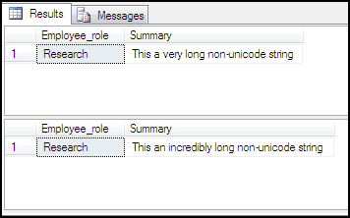
SQL
Server
2012
SQL
Server
2012
Following figure displays the output of .WRITE clause query:

Slide 39
SQL
Server
2012
SQL
Server
2012
It specifies the order in which the columns should be sorted in a resultset.
By default, records are sorted in an ASC order. To switch to the descending mode,
use the optional keyword DESC.
Syntax:
SELECT <column_name> FROM <table_name> ORDER BY column_name> {ASC|DESC}

Slide 40
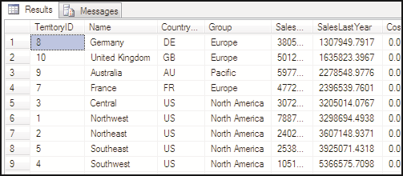
SQL
Server
2012
SQL
Server
2012
The SELECT statement in the following code snippet sorts the query results on the
SalesLastYear column of the Sales.SalesTerritory table:
USE AdventureWorks2012
SELECT * FROM Sales.SalesTerritory ORDER BY SalesLastYear GO
The output is shown in the following figure:

Slide 41
SQL
Server
2012
SQL
Server
2012
Extensible Markup Language (XML) allows developers to develop their own set of
tags and makes it possible for other programs to understand these tags.
Applications of today have a mix of technologies such as ASP, Microsoft .NET technologies, XML, and SQL Server 2012 working in tandem.

Slide 42
SQL
Server
2012
SQL
Server
2012
Native XML databases in SQL Server 2012 have a number of advantages. Some of them are listed as follows:
Easy Data Search and Management
All the XML data is stored locally in one place, thus making it easier to search and manage.
Better Performance
Queries from a well-implemented XML database are faster than queries over documents stored in a file system.
Also, the database essentially parses each document when storing it.
Easy data processing
Large documents can be processed easily.
SQL Server 2012 supports native storage of XML data by using the xml data type.

Slide 43

SQL
Server
2012
SQL
Server
2012
In addition to regular commonly used data types, SQL Server 2012 provides a brand new data type in the form of xml data type.
An XML fragment is an XML instance with the top-level element missing from its structure.
The syntax to create a table with columns of type xml is as follows:
Syntax:
CREATE TABLE <table_name> ( [ column_list,] <column_name> xml [, column_list])

Slide 44

SQL
Server
2012
SQL
Server
2012
Following code snippet creates a new table named PhoneBilling with one of the columns belonging to xml data type:
USE AdventureWorks2012
CREATE TABLE Person.PhoneBilling (Bill_ID int PRIMARY KEY, MobileNumber
bigint UNIQUE, CallDetails xml) GO
A column of type xml can be added to a table at the time of creation or after its creation.
The xml data type columns support DEFAULT values as well as the NOT NULL
constraint.
Data can be inserted into the xml column in the Person.PhoneBilling table as
shown in the following code snippet:
USE AdventureWorks2012
INSERT INTO Person.PhoneBilling VALUES (100,9833276605,
'<Info> <Call>Local</Call> <Time>45 minutes </Time> <Charges> 200
</Charges> </Info>')
SELECT CallDetails FROM Person.PhoneBilling GO

Slide 45


SQL
Server
2012
SQL
Server
2012
The output is shown in the following figure:
The DECLARE statement is used to create variables of type xml.
Following code snippet shows how to create a variable of type xml:
DECLARE @xmlvar xml
SELECT @xmlvar='<Employee name="Joan" />‘
The xml data type columns cannot be used as a primary key, foreign key, or as a unique constraint.

Slide 46



SQL
Server
2012
SQL
Server
2012
There are two ways of storing XML documents in the xml data type columns, namely, typed and untyped XML.
It describes the structure and limits the contents of XML documents by associating xml data types with XML element types and attributes.
SQL Server does not perform any validation for data entered in the xml column. However, it ensures that the data that is stored is well-formed.

Slide 47

SQL
Server
2012
SQL
Server
2012
The first step in using typed XML is registering a schema.
This is done by using the CREATE XML SCHEMA COLLECTION statement as
shown in the following code snippet:
USE SampleDB
CREATE XML SCHEMA COLLECTION CricketSchemaCollection
AS N'<xsd:schema xmlns:xsd="http://www.w3.org/2001/XMLSchema" >
<xsd:element name="MatchDetails">
<xsd:complexType>
<xsd:complexContent>
<xsd:restriction base="xsd:anyType">
<xsd:sequence>
<xsd:element name="Team" minOccurs="0" maxOccurs="unbounded">
<xsd:complexType>
<xsd:complexContent>
<xsd:restriction base="xsd:anyType">
<xsd:sequence />
<xsd:attribute name="country" type="xsd:string" />
<xsd:attribute name="score" type="xsd:string" />

Slide 48

SQL
Server
2012
SQL
Server
2012
</xsd:restriction>
</xsd:complexContent>
</xsd:complexType>
</xsd:element>
</xsd:sequence>
</xsd:restriction>
</xsd:complexContent>
</xsd:complexType>
</xsd:element>
</xsd:schema>' GO
The CREATE XML SCHEMA COLLECTION statement creates a collection of schemas, any of which can be used to validate typed XML data with the name of the collection.
This example shows a new schema called CricketSchemaCollection being
added to the SampleDB database.
Once a schema is registered, the schema can be used in new instances of the xml
data type.

Slide 49

SQL
Server
2012
SQL
Server
2012
Following code snippet creates a table with an xml type column and specifies a schema for the column:
USE SampleDB
CREATE TABLE CricketTeam ( TeamID int identity not null, TeamInfo xml(CricketSchemaCollection) )
GO
To create new rows with the typed XML data, the INSERT statement can be used as
shown in the following code snippet:
USE SampleDB
INSERT INTO CricketTeam (TeamInfo) VALUES ('<MatchDetails><Team country="Australia" score="355"></Team><Team country="Zimbabwe" score="200"></Team><Team country="England" score="475"></Team></MatchDetails>')
GO
A typed XML variable can also be created by specifying the schema collection name as shown in the following code snippet:
USE SampleDB
DECLARE @team xml(CricketSchemaCollection)
SET @team = '<MatchDetails><Team country="Australia"></Team></MatchDetails>'
SELECT @team
GO

Slide 50



SQL
Server
2012
SQL
Server
2012
After XML data has been stored using the xml data type, it can be queried and retrieved using a language named XQuery.
XQuery can be query structured or semi-structured XML data.
Developers need to query XML documents, and this involves transforming XML documents in the required format.

Slide 51



SQL
Server
2012
Some of the xml data type methods used with XQuery are described as follows:
exist()
This method is used to determine if one or more specified nodes are present in the XML document.
It returns 1 if the XQuery expression returned at least one node, 0 if the Xquery expression evaluated to an empty result, and NULL if the xml data type instance against which the query was executed is NULL.
Following code snippet demonstrates the use of exist() method:
SQL
Server
2012
USE SampleDB
SELECT TeamID FROM CricketTeam WHERE TeamInfo.exist('(/MatchDetails/Team)') = 1
GO
This will return only those TeamID values where the Team element has been specified in the TeamInfo. The output is shown in the following figure:

Slide 52



SQL
Server
2012
SQL
Server
2012
query()
The query() method can be used to retrieve either the entire contents of an XML
document or a selected section of the XML document.
Following code snippet shows the use of query() method:
USE SampleDB
SELECT TeamInfo.query('/MatchDetails/Team') AS Info FROM CricketTeam GO
The output is shown in the following figure:

Slide 53


SQL
Server
2012
SQL
Server
2012
value()
The value() method can be used to extract scalar values from an xml data type.
Following code snippet demonstrates the use of this method:
USE SampleDB
SELECT TeamInfo.value('(/MatchDetails/Team/@score)[1]', 'varchar(20)') AS
Score FROM CricketTeam where TeamID=1
GO
The output is shown in the following figure:

Slide 54

SQL
Server
2012
SQL
Server
2012
The SELECT statement retrieves rows and columns from tables.
SELECT statement allows the users to specify different expressions in order to view
the resultset in an ordered manner.
A SELECT statement can contain mathematical expressions by applying operators to one or more columns.
The keyword DISTINCT prevents the retrieval of duplicate records.
XML allows developers to develop their own set of tags and makes it possible for
other programs to understand these tags.
A typed XML instance is an XML instance which has a schema associated with it.
XML data can be queried and retrieved using XQuery language.

